Slide 1
Eco-Feedback For Energy Literacy
Michael Wintersperger
Research Unit of Computer Graphics
Institute of Visual Computing & Human-Centered Technology
TU Wien, Austria

Slide 2

Agenda
Motivation
Plan
Expected Outcome
Current State of Development
Q & A

Slide 3
Motivation
Energy Crisis
Rising Prices
Energy Consumption Awareness
Finishing my Bachelor Thesis

Slide 4
Plan
Literature Research
Feasability
Design
Prototype
Hardware
Software ← I am here
Testing
User Study

Slide 5
Expected Outcome
Increased Energy Literacy
Decreased Energy Consumption
Improved Energy Budgeting
Reduced Energy Bill

Slide 6
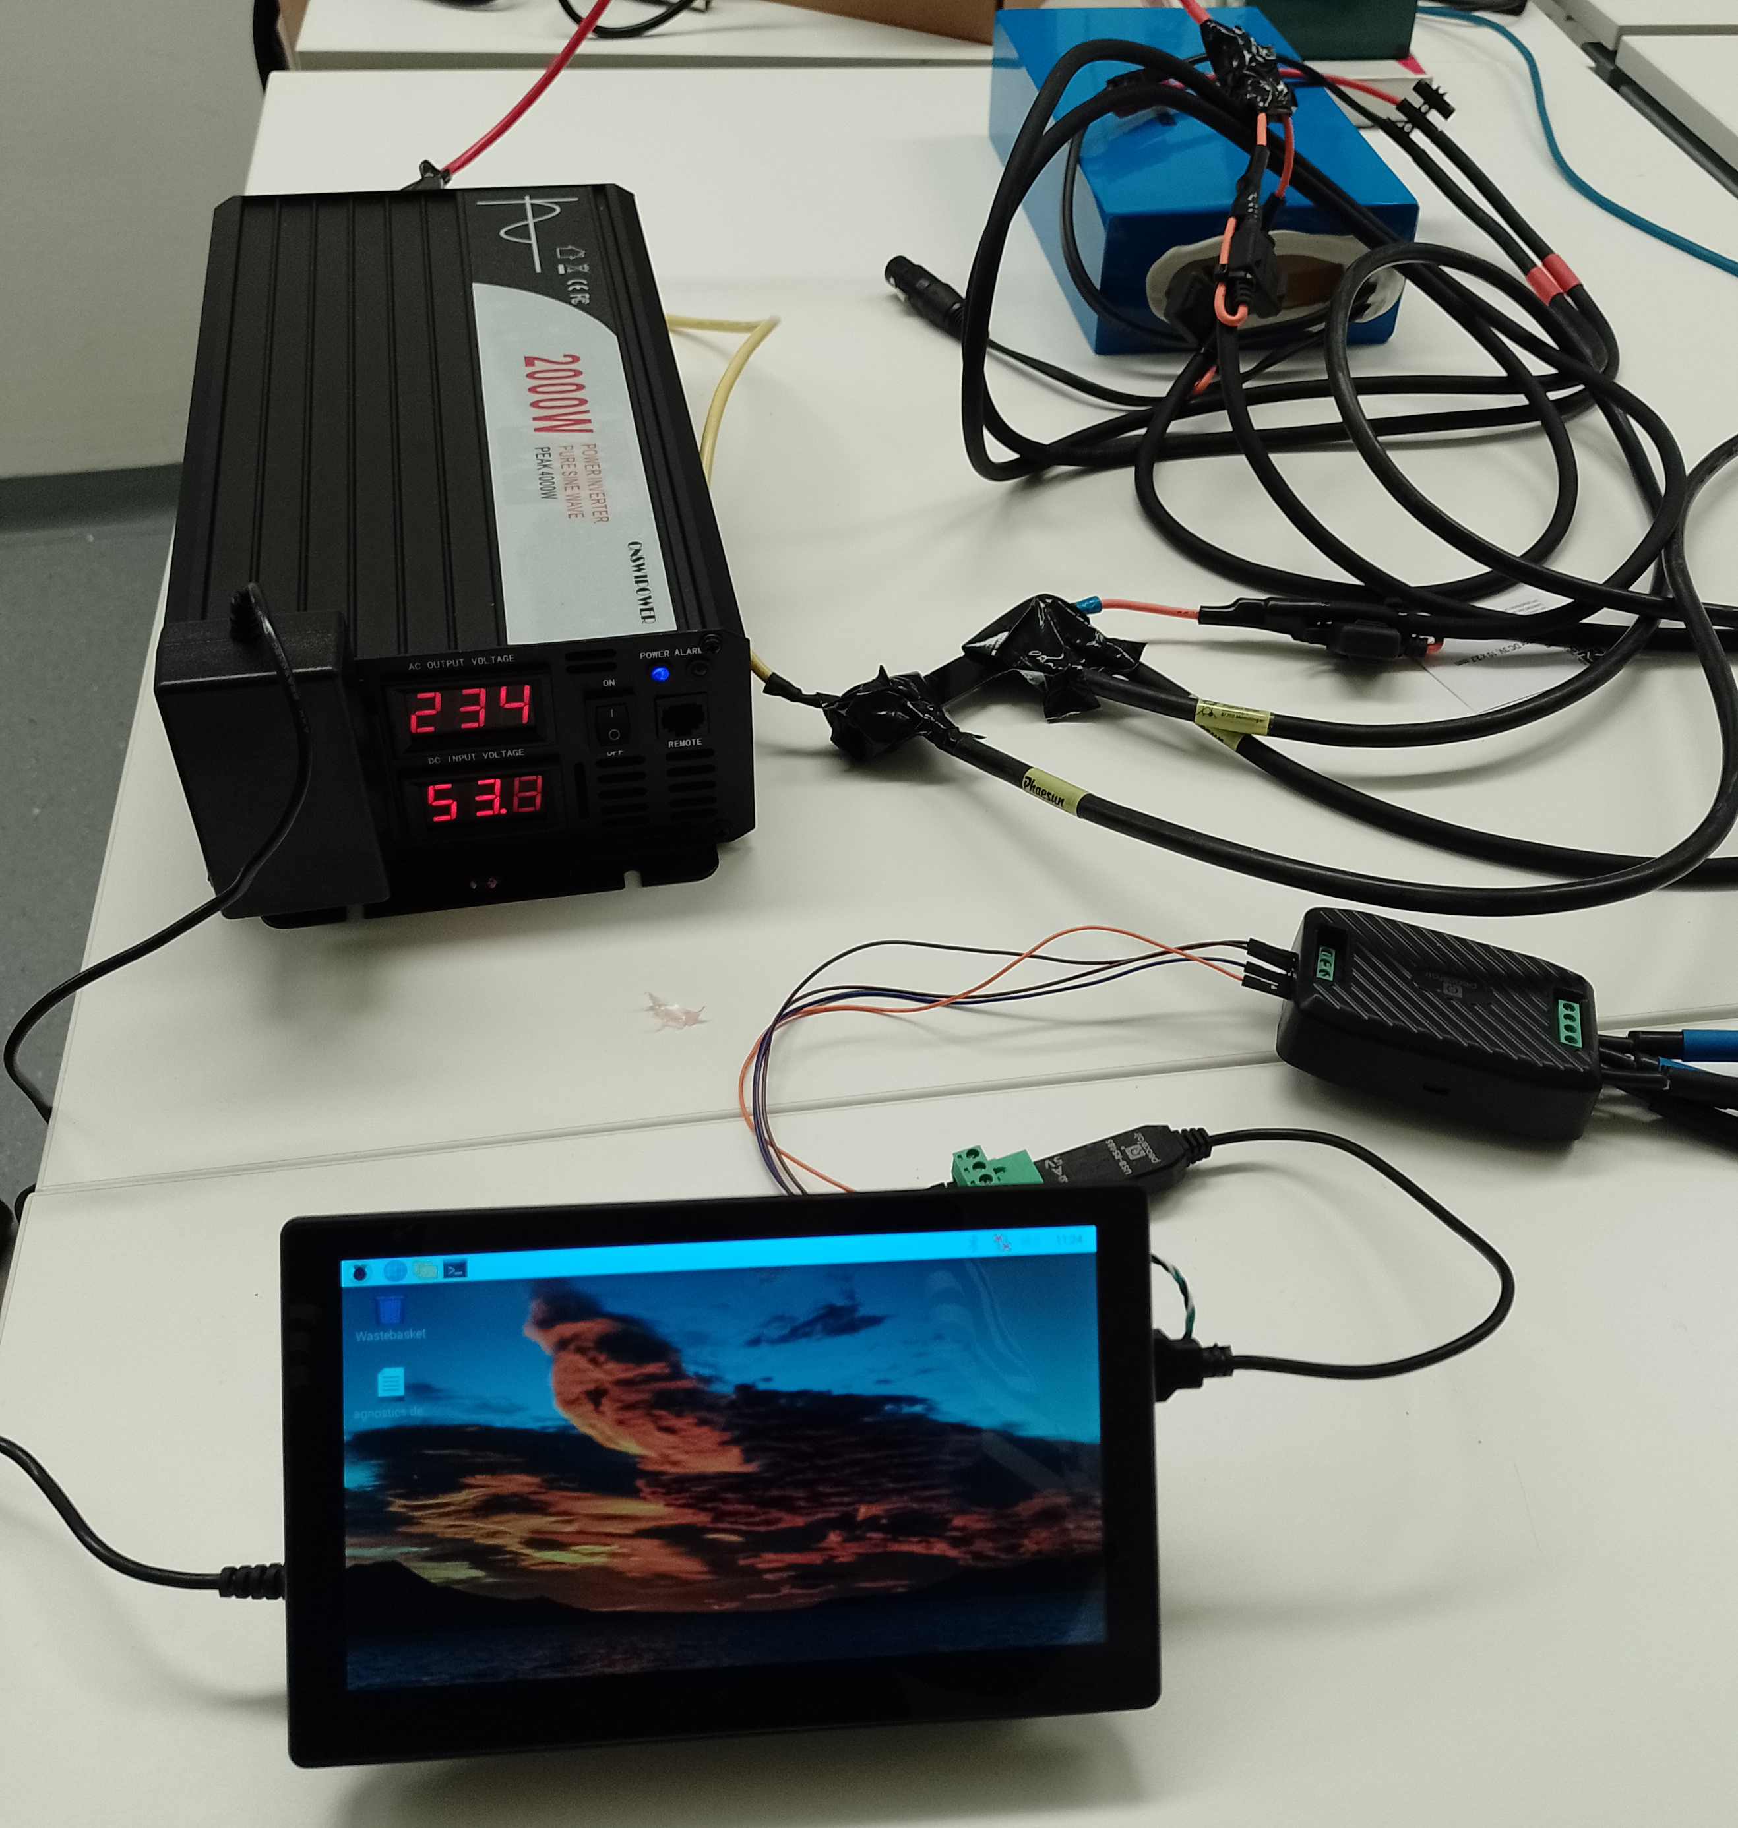
Current State - Hardware
Battery: 48V 20Ah
Transformer: 60V-230V
Raspberry: 4B
Touchscreen: 7“
Energy Meter:
Peacefair PZEM 016
Cabling: 30 A

Slide 7
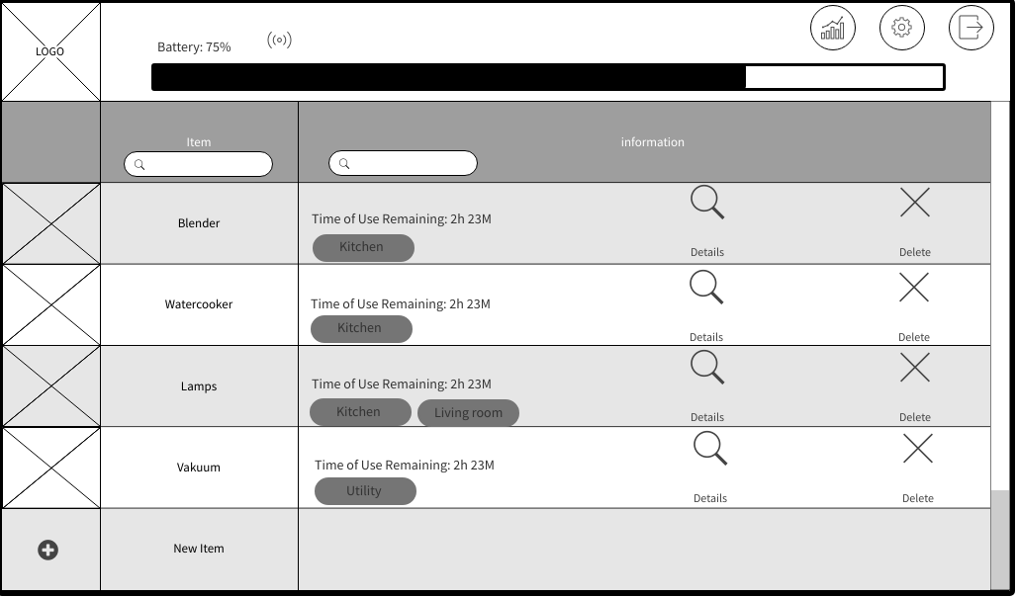
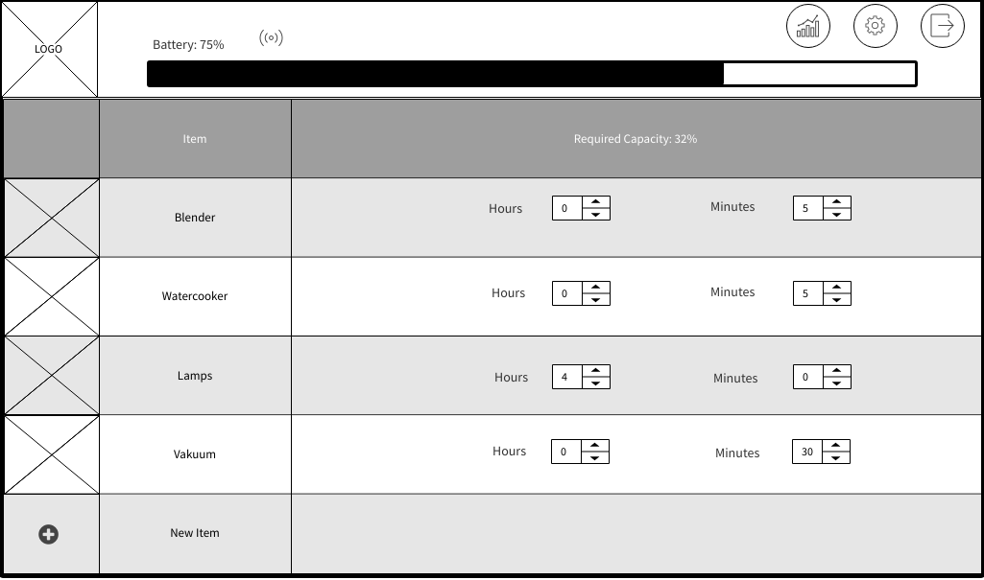
Current State - Software
Mockup:
Mockflow Wireframe
Python: 3.10
Database: SQLite
Communication:
RS485
PyModbus
GUI: PyQt5

Slide 8

Q & A

Slide 9
Thank You for your Attention!
Feedback is welcome and so are interrested testers.

